Slide 1
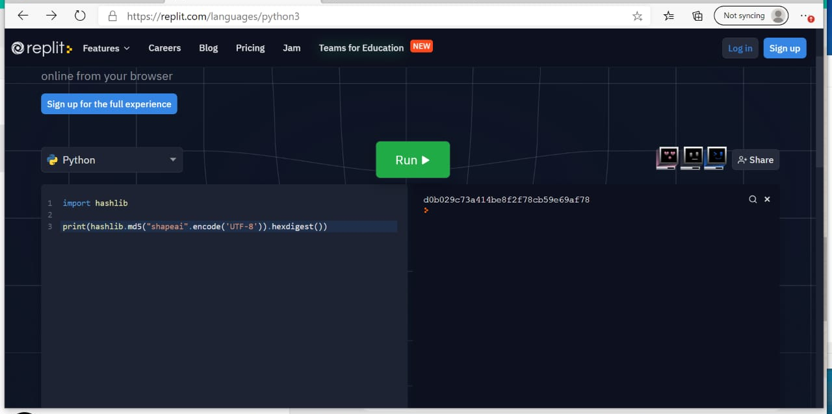
PROJECT
Name : MAHESWARI V
EMAIL :gingersnowypopcorn@gmail.com

Slide 2
(AS I CAN’T ABLE TO DOWNLOAD SOFTWARE I TYPED HERE ) Also I provided the screenshot of execution on the first slide also in the below link copy n paste the coding part to see output https://replit.com/languages/python3
import hashlib
print(hashlib.md5("shapeai".encode ('UTF-8')).hexdigest())
OUTPUT
d0b029c73a414be8f2f78cb59e69af78

